Slide 1
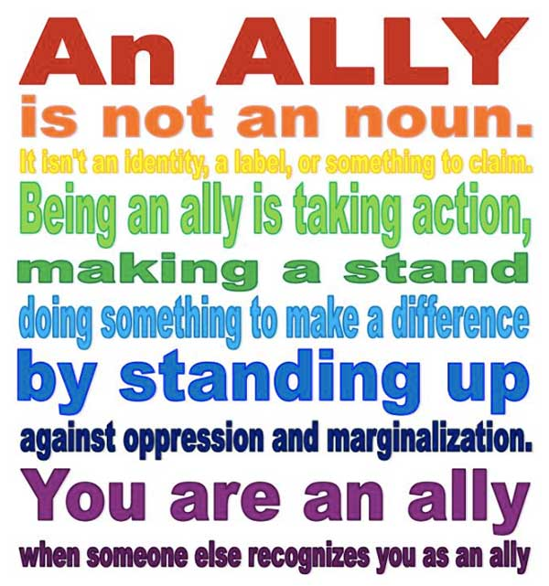
Allies and Accomplices
Linda Akli, Assistant Director
Training, Education, & Outreach
Notes:
Hello, I’m Linda Akli, SURA Assistant Director of Training, Education & Outreach and the Broadening Participation Manager for XSEDE.
I’ll take my 5 minutes to discuss internal allies, external allies, and accomplices.

Slide 2
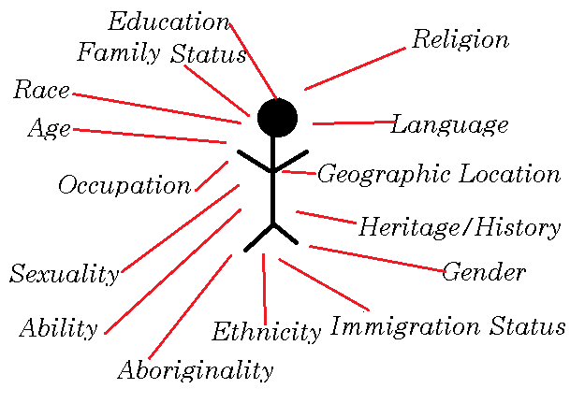
Internal Allies
Intersectionality
Notes:
Many times we think about cultivating allies as involving people from outside such as white people in civil rights, Christians against anti-Semitism or men supporting women’s rights. It is also important to do an inward look to see if we are really inclusive. Within the group, is everyone represented and the full spectrum of issues they face being considered?
To do so you have to understand the impact of intersectionality. Many times voices within the community are missing because we consider groups as monolithic in experience or perspective. Ethnicity, geographic location, race, age all contribute to a person’s identify and shape our experiences. Not all women have the same experiences. Not all women of color are the same.
My grandmother grew up in Newark, NJ and was able to vote when women won the right to vote on August 18, 1920 just as she turned 21. Her ability to affect change in her community was different than her cousin Clarice in Wilmington, North Carolina, who was still disenfranchised and had to wait until the Civil Rights Act of 1964 before she could vote. Can you imagine the differences in their perspective?
It is also important to recognize intersectionality issues are global. Part of my family is from Cuba, part from Togo, West Africa, and some live in Germany and France. We’re all black women with significantly different experiences but many common issues. So it is key to respect, understand and incorporate the full spectrum of women’s experience. This means also including a variety of voices in leadership roles. There is strength in numbers but everyone has to be empowered.

Slide 3
External Allies
Share Stories
Operate with Respect
Maximize Teaching Moments
Notes:
More traditionally, an ally is someone who doesn’t experience the marginalization, discrimination, or harassment but is supportive of those who do.
How do you cultivate external allies? Share your stories. Recognize the community of men is just as diverse as our community of women. Understand there is male intersectionality. Use those teaching moments.
Allies can be from unexpected sources. My first job after college was at AT&T Long Lines and my first supervisor was an older white male who was formerly a linesman. He did not hire me or even select me for his team. However, he had big impact on my career. He encouraged me to take risks. In his words, if things didn’t break regularly I wasn’t really working. He also encouraged me to take part in the company stock plan and freely shared career advice. In 1978, I was a workplace anomaly as a black technologist; Jim Byrnes and I were an unlikely team.
What are teaching moments? When I served on the XSEDE16 executive committee, during one of our site visits, we witnessed an encounter where a snarky white male acted as if Kelly Gaither was a twit in front of the entire XSEDE16 executive committee. When the man left the meeting, we all reflected on what happened. For the male members of the committee, it had a profound effect. They were direct witness to an incident that normally doesn’t happen publically. Many times in my role as lead for XSEDE’s Broadening Participation Program, team members have witnessed flagrant incidents because I’m a black female in a leadership role. Each incident results in many allies and a few accomplices.

Slide 4
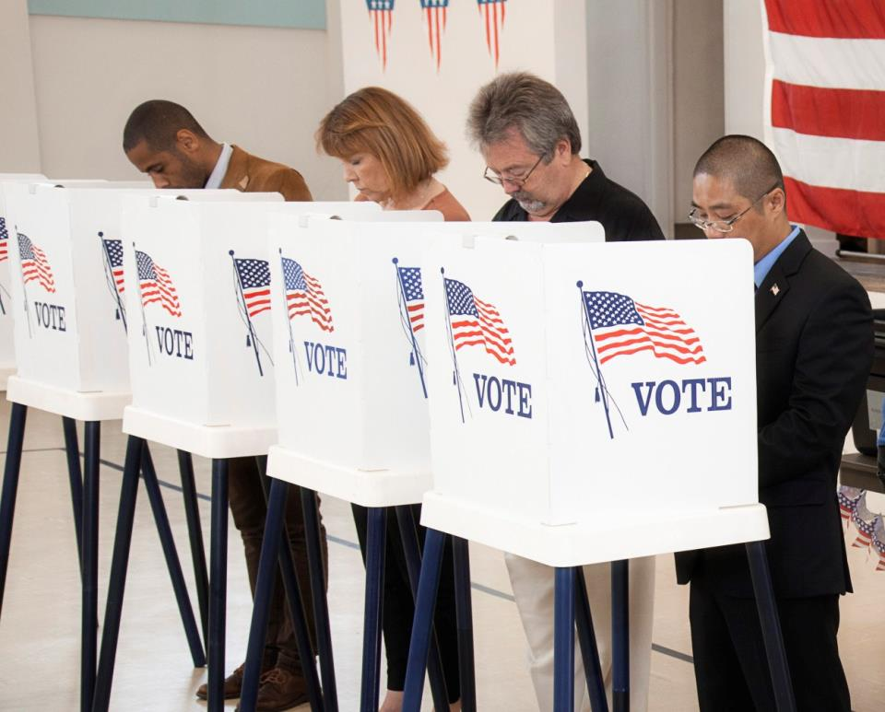
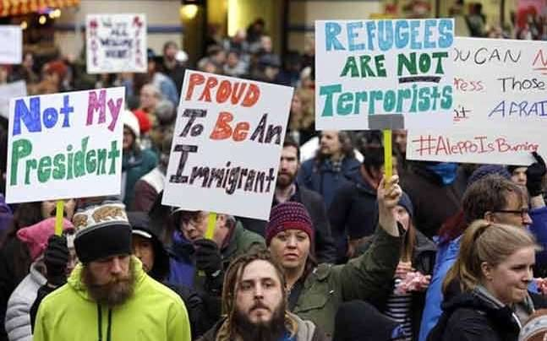
Accomplices
“… so many of us are not willing to lose anything … and we have to recognize that’s where change happens.”
Notes:
The bottom line and innovation is enhanced by more diverse and inclusive teams.
However, marginalization, discrimination, harassment, disparate pay, glass ceilings, and exclusionary work environments are social justice issues. As such, a social justice framework is needed to effect change.
Actor – Someone who watches from the side lines and may join in when it’s comfortable.
Ally – Someone who provides support through listening, funding, may intervene when witnessing an incident.
Accomplice – Though has negative connotations due to how it is used in the judicial system, is my preference. An accomplice is willing to take risks and help dismantle the systems and structures that continue to enable marginalization, discrimination, harassment, and violence to occur against women.
There are excellent references from the social justice community that apply to making the changes to the advanced technology industry for full inclusion to occur and it starts with addressing the structural and systemic issues.
References; CODEPINK (women-led grassroots organization working to end U.S. wars and militarism, support peace and human rights initiatives, healthcare, education, green jobs and other life-affirming programs), Southern Poverty Law Center, website - Opportunities for White People in the Fight for Racial Justice, and other social justice organizations.

